Slide 1

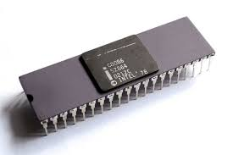
Programming with Intel 8086
18ECC203J: Module – 2
Faculty of Engineering and Technology, SRM Institute of Science and Technology
Organized by
Dr. K. A. Sunitha, Associate Professor, EIE, SRMIST
Dr. B. Ramakrishna, Assistant Professor, ECE, SRMIST
Picture Courtesy :Google

Slide 2
Session - 1
Addressing modes of 8086

Slide 3
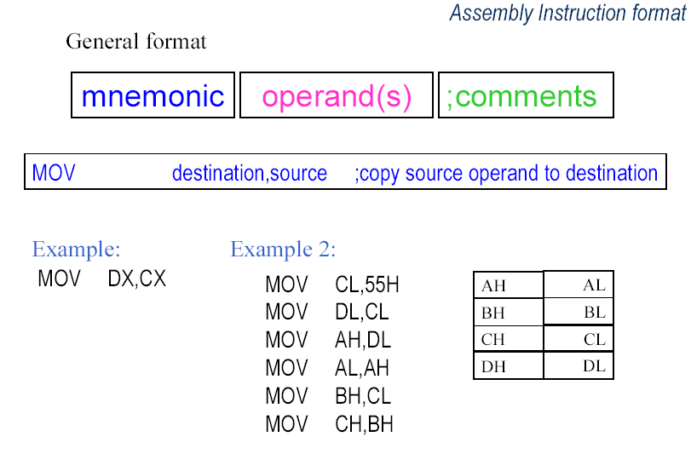
Assembly Instruction Format
Picture Courtesy :Google

Slide 4
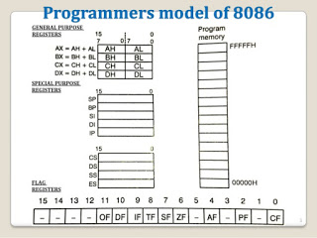
@ Students…Recall the registers of 8086
Picture Courtesy :Google

Slide 5
Addressing Modes in 8086
Register addressing mode
Immediate addressing mode
Data memory addressing modes
Direct, Base, Index,
Program memory addressing modes
Stack memory addressing modes

Slide 6
Register Addressing Mode
In this addressing mode, the data present in register is moved or manipulated and the result is stored in register.
Examples:
MOV AL,BL ; Move content of BL to AL
MOV CX,BX ; Move content of BX to CX
ADD CL,BL ; Add content of CL and BL and store result in CL
ADC BX,DX ; Add content of BX, carry flag and DX, and store result in BX

Slide 7
Immediate Addressing Mode
In this mode, the data is directly given in the instruction.
Examples:
MOV AL,50H ; Move data 50H to AL
MOV BX,23A0H ; Move data 23A0H to BX
MOV [SI],43C0H ; Move data 43C0H to memory at [SI]
In the last example, [SI] represents the memory location in data segment at the offset address specified by SI register.

Slide 8
Data Memory Addressing Modes
The term Effective Address (EA) represents the offset address of the data within a segment which is obtained by different methods, depending upon the addressing mode that is used in the instruction.
Let us assume that the various registers in 8086 have the following values stored in them.

Slide 9
Direct Addressing Mode:
In this mode, the 16 bit offset address of the data within the segment is directly given in the instruction.
Examples: @ DS = 3000H
a) MOV AL, [1000H]
EA is given within square bracket in the instruction in this addressing mode and hence EA=1000H in the above instruction. Since the destination is an 8-bit register (i.e. AL), a byte is taken from memory at the address given by DS x 10H + EA=31000H and stored in AL.
b) MOV BX,[2000H]
EA=2000H in this instruction. Since the destination is a 16 bit register (i.e. BX), a word is taken from memory address DSx10H+EA =32000H and stored in BX. (Note: Since a word contains two bytes, the byte present at memory address 32000H and 32001H are moved to BL and BH respectively.)

Slide 10
Base Addressing Mode
In this mode, the EA is the content of BX or BP register. When BX register is present in the instruction, data is taken from the data segment and if BP is present in the instruction, data is taken from the stack segment.
Examples: @ DS = 3000H
MOV CL,[BX] EA=(BX)=2000H
Memory address=DSx10+(BX)=32000H. The byte from the memory address 32000H is read and stored in CL.
@ SS = 3000H
MOV DX,[BP] EA=(BP)=1000H
Memory address=SSx10H+(BP)=41000H. The word from the memory address 41000H is read and stored in DX.

Slide 11
Base Relative Addressing Mode
In this mode, the EA is obtained by adding the content of the base register with an 8-bit or 16 bit displacement. The displacement is a signed number with negative values represented in two’s complement form. The 16 bit displacement can have value from -32768 to +32767 and 8 bit displacement can have the value from -128 to +127.
Examples: @ DS = 3000H
MOV AX,[BX+5] EA=(BX)+5
Memory address=DSx10H+(BX)+5 = 30000H+2000H+5=32005H
The word from the memory address 32005H is taken and stored in AX.
MOV CH,[BX-100H] EA=(BX)-100H
Memory address=DSx10H+(BX)-100H = 30000H+2000H-100H=31F00H
The byte from the memory address 31F00H is taken and stored in CH.

Slide 12
Index Addressing Mode
In this mode, the EA is the content of SI or DI register which is specified in the instruction. The data is taken from data segment.
Examples: @ DS = 3000H
MOV BL,[SI] EA=(SI)=1000H
Memory address=DSx10H+SI=30000H+1000H=31000H
A byte from the memory address 31000H is taken and stored in BL.
MOV CX,[DI] EA=(DI)=3000H
Memory address=DSx10H+(DI)=30000H+3000H=33000H
A word from the memory address 33000H is taken and stored in CX.

Slide 13
Index Relative Addressing Mode
This mode is same as base relative addressing mode except that instead of BP or BX register, SI or DI register is used.
Example @ DS = 3000H
MOV BX,[SI-100H] EA=(SI)-100H
Memory Address=DSx10H+(SI)-100H = 30000H+1000H-100H =30F00H
A word from the memory address 30F00H is taken and stored in BX.
MOV CL,[DI+10H] EA=(DI)+10H
Memory address=DSx10H+(DI)+10H =30000H+3000H+10H = 33010H
A byte from the memory address 33010H is taken and stored in CL.

Slide 14
Base Plus Index Addressing Mode
In this mode, the EA is obtained by adding the content of a base register and index register.
Example
MOV AX,[BX+SI] EA=(BX)+(SI)
Memory address=DSx10H+(BX)+(SI)=30000H+2000H+1000H =33000H
A word from the memory address 33000H is taken and stored in AX.
Base relative, index relative and base plus index addressing modes are used to access a byte or word type data from a table of data or an array of data stored in data segment one by one.

Slide 15
Base Relative Plus Index Addressing Mode
In this mode, the EA is obtained by adding the content of a base register, an index and a displacement.
Example:
MOV CX,[BX+SI+50H] EA= (BX)+(SI)+50H
Memory address=DSx10H+(BX)+(SI)+50H
=30000H+2000H+1000H+50H
=33050H
A word from the memory address 33050H is taken and stored in CX.
Base relative plus index addressing is used to access a byte or a word in a particular record of a particular file in memory. A particular application program may process many files stored in the data segment.
Each file contains many records and a record contains few bytes or words of data. In base relative plus index addressing, base register may be used to hold the offset address of a particular file in the data segment; index register may be used to hold the offset address of a particular record within that file and the relative value is used to indicate the offset address of particular byte or word within that record.

Slide 16
Program Memory Addressing Mode
Program memory addressing modes are used with JMP and CALL instructions and consist of three distinct forms namely direct, relative and indirect.
Direct Addressing: The direct program memory addressing stores both the segment and offset address where the control has to be transferred with the opcode.
The above instruction is equivalent to JMP 32000H.
When it is executed, the 16 bit offset value 2000H is loaded in IP register and the 16 bit segment value 3000H is loaded in CS.
When the microprocessor calculates the memory address from where it has to fetch an instruction using the relation CSx10H+IP, the address 32000H will be obtained using the above CS and IP values.

Slide 17
Relative Addressing Mode
The term relative here means relative to the instruction pointer (IP). Relative JMP and CALL instructions contain either an 8 bit or a 16 bit signed displacement that is added to the current instruction pointer and based on the new value of IP thus obtained, the address of the next instruction to be executed is calculated using the relation CSx10H+IP.
The 8-bit or 16 bit signed displacement which allows a forward memory reference or a reverse memory reference. A one byte displacement is used in short jump and call instructions, and a two byte displacement is used in near jump and call instructions. Both types are considered intersegment jumps since the program control is transferred anywhere within the current code segment.
An 8 bit displacement has a jump range of between +127 and -128 bytes from the next instruction while a 16 bit displacement has a jump range of between -32768 and +32767 bytes from the next instruction following the jump instruction in the program. The opcode of relative short jump and near jump instructions are EBH and E9H respectively.
While using assembler to develop 8086 program, the assembler directive SHORT and NEAR PTR is used to indicate short jump and near jump instruction respectively.
Examples:
a) JMP SHORT OVER
b) JMP NEAR PTR FIND
In the above examples, OVER and FIND are the label of memory locations that are present in the same code segment in which the above instructions are present.

Slide 18
Indirect Addressing Mode
The indirect jump or CALL instructions use either any 16 bit register (AX,BX,CX,DX,SP,BP,SI or DI) or any relative register ([BP],[BX],[DI] or [SI]) or any relative register with displacement. The opcode of indirect jump instruction is FFH. It can be either intersegment indirect jump or intersegment indirect jump instruction
If a 16 bit register holds the jump address of in a indirect JMP instruction, the jump is near. If the CX register contains 2000H and JMP CX instruction present in a code segment is executed, the microprocessor jumps to offset address 2000H in the current code segment to take the next instruction for execution (This is done by loading the IP with the content of CX without changing the content of CS).
When the instruction JMP [DI] is executed, the microprocessor first reads a word in the current data segment from the offset address specified by DI and puts that word in IP register. Now using this new value of IP, 8086 calculates the address of the memory location where it has to jump using the relation CSx10H+IP.

Slide 19
Stack Memory Addressing Mode
The stack holds data temporarily and also stores return address for procedures and interrupt service routines. The stack memory is a last-in, first-out (LIFO) memory. Data are placed into the stack using PUSH instruction and taken out from the stack using POP instruction. The CALL instruction uses the stack to hold the return address for procedures and RET instruction is used to remove return address from stack.
The stack segment is maintained by two registers: the stack pointer (SP) and the stack segment register (SS). Always a word is entered into stack. Whenever a word of data is pushed into the stack, the higher-order 8 bits of the word are placed in the memory location specified by SP-1 (i.e. at address SSx10H + SP-1)and the lower-order 8 bits of the word are placed in the memory location specified by SP-2 in the current stack segment (SS) (i.e. at address SSx10H + SP-2). The SP is then decremented by 2. The data pushed into the stack may be either the content of a 16 bit register or segment register or 16 bit data in memory.
Since SP gets decremented for every push operation, the stack segment is said to be growing downwards as for successive push operations, the data are stored in lower memory addresses in stack segment. Due to this, the SP is initialized with highest offset address according to the requirement, at the beginning of the program.

Slide 20
Segment Override Prefix
The segment override prefix which can be added to almost any instruction in any memory related addressing mode, allows the programmer to deviate from the default segment and offset register mechanism. The segment override prefix is an additional byte that appears the front of an instruction to select an alternate segment register. The jump and call instructions cannot be prefixed with the segment override prefix since they use only code segment register (CS) for address generation.
Example:
MOV AX,[BP] instruction accesses data within stack segment by default since BP is the offset register for stack segment. But if the programmer wants to get data from data segment using BP as offset register in the above instruction, then the instruction is modified as
MOV AX, DS:[BP]

Slide 21
Session - 2
Instruction Set of 8086: Data Transfer Instructions
&
Example programs

Slide 22
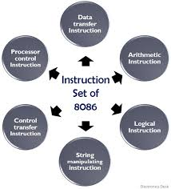
Towards…..
Picture Courtesy :Google

Slide 23
Instruction Set Classification of 8086
The instructions of 8086 are classified into
Data transfer,
Arithmetic,
Logical,
Flag manipulation,
Machine control instructions
Shift/rotate,
String manipulation and

Slide 24
Data Transfer Instructions
The Data Transfer Instructions include
MOV,
PUSH, POP,
XCHG, XLAT,
IN, OUT,
LEA, LDS, LES, LSS,
LAHF and SAHF

Slide 25
Data Transfer Instructions
MOV: MOV instruction copies a word or byte of data from a specified source to a specified destination. The destination can be a register or a memory location. The source can be a register or a memory location or an immediate number. The general format of MOV instruction is
MOV Destination, Source
Examples: MOV BL, 50H ; Move immediate data 50H to BL
MOV CX, [BX] ; Copy word from memory at [BX] to CX
MOV AX, CX ; Copy contents of CX to AX
Note: [BX] indicates the memory location at offset address specified by BX in data segment.

Slide 26
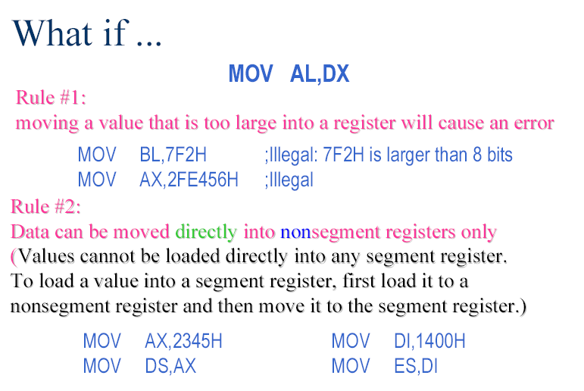
Rule #3:
If a value less than FFH is moved into a 16-bit register, the rest of the
bits are assumed to be all zeros.
MOV BX, 5 BX =0005
BH = 00, BL = 05

Slide 27
Data Transfer Instructions
PUSH: PUSH instruction is used to store the word in a register or a memory location into stack as explained in stack addressing modes. SP is decremented by 2 after execution of PUSH.
Examples:
PUSH CX; PUSH CX content in stack
PUSH DS; PUSH DS content in stack
PUSH [BX]; PUSH word in memory at [BX] into stack
PUSH [5000H]; content of location 5000H & 5001H in DS are pushed onto the stack

Slide 28
Data Transfer Instructions
POP: POP instruction copies the top word from the stack to a destination specified in the instruction. The destination can be a general purpose register, a segment register or a memory location. After the word is copied to the specified destination, the SP is incremented by 2 to point to the next word in the stack.
Examples:
POP BX ; Pop BX content from the stack
POP DS ; Pop DS content from the stack
POP [SI] ; Pop a word from the stack and store it in memory at [SI]
Note: [SI] indicates the memory location in data segment at offset address specified by SI.

Slide 29
Data Transfer Instructions
XCHG: The XCHG instruction exchanges the contents of a register with the contents of a memory location. It cannot exchange directly the contents of two memory locations. The source and destination must both be words or they must both be bytes. The segment registers cannot be used in this instruction.
Examples:
XCHG AL, BL; Exchanges content of AL and BL
XCHG CX, BX; Exchanges content of CX and BX
XCHG AX, [BX]; Exchanges content of AX with content of memory at [BX]
XLAT: The XLAT instruction is used to translate a byte in AL from one code to another code. The instruction replaces a byte in the AL register with a byte in memory at [BX], which is data in a lookup table present in memory.
Before XLAT is executed, the lookup table containing the desired codes must be put in data segment and the offset address of the starting location of the lookup table is stored in BX. The code byte to be translated is put in AL. When XLAT is now executed, it adds the content of the AL with BX to find the offset address of the data in the above lookup table and the byte in that offset address is copied to AL.

Slide 30
Data Transfer Instructions
IN: The IN instruction copies data from a port to AL or AX register. If an 8-bit port is read, the data is stored in AL and if a 16 bit port is read, the data is stored in AX. The IN instruction has two formats namely fixed port and variable port.
For the fixed port type IN instruction, the 8-bit address of a port is specified directly in the instruction. With this form, anyone of 256 possible ports can be addressed.
Examples:
IN AL, 80H; Input a byte from the port with address 80H to AL
IN AX, 40H; Input a word from port with address 40H to AX
For the variable port type IN instruction, the port address is loaded into DX register before the IN instruction. Since DX is a 16 bit register, the port address can be any number between 0000H and FFFFH. Hence up to 65536 ports are addressable in this mode. The following example shows a part of the program having IN instruction and the operations done when the instructions are executed are given in the corresponding comment field.
Examples:
MOV DX, 0FE50H ; Initialize DX with port address of FE50H
IN AL, DX ; Input a byte from 8-bit port with port address FE50H into AL
IN AX, DX ; Input a word from 16-bit port with port address FE50H into AX

Slide 31
Data Transfer Instructions
OUT: The OUT instruction transfers a byte from AL or a word from AX to the specified port. Similar to IN instruction, OUT instruction has two forms namely fixed port and variable port.
Examples for fixed port OUT instruction:
OUT 48H,AL ; Send the content of AL to port with address 48H
OUT 0F0H,AX ; Send the content of AX to port with address FOH
Example for variable port OUT instruction:
The following example shows a part of the program having OUT instruction and the operations done when the instructions are executed are given in the corresponding comment field.
MOV DX, 1234H; Load port address 1234H in DX
OUT DX, AL; Send the content of AL to port with address 1234H
OUT DX,AX; Send the content of AX to port with address 1234H

Slide 32
Data Transfer Instructions
LEA: Load Effective Address
The general format of LEA instruction is
LEA register, source
This instruction determines the offset address of the variable or memory location named as the source and puts this offset address in the indicated 16 bit register.
Examples:
LEA BX, COST; Load BX with offset address of COST in data segment where
COST is the name assigned to a memory location in data segment.
LEA CX, [BX][SI]; Load CX with the value equal to (BX)+(SI) where (BX) and
(SI) represents content of BX and SI respectively.

Slide 33
Data Transfer Instructions
LDS: Load register and DS with words from memory
The general form of this instruction is
LDS register, memory address of first word
The LDS instruction copies a word from the memory location specified in the instruction into the register and then copies a word from the next memory location into the DS register.
LDS is useful for initializing SI and DS registers at the start of a string before using one of the String instructions.
Example:
LDS SI,[2000H]; Copy content of memory at offset address 2000H in data segment to lower byte of SI, content of 2001H to higher byte of SI. Copy content at offset address 2002H in data segment to lower byte of DS and 2003H to higher byte of DS.

Slide 34
Data Transfer Instructions
LES, LSS: LES and LSS instructions are similar to LDS instruction except that instead of DS register, ES and SS registers are loaded respectively along with the register specified in the instruction.
LAHF: This instruction copies the low byte of flag register into AH.
SAHF: Store content of AH in the low byte of flag register.
Except SAHF and POPF instructions, all other data transfer instructions do not affect flag register.

Slide 35
Session - 3
Data Conversion Instructions, Arithmetic Instructions
&
Example Programs

Slide 36
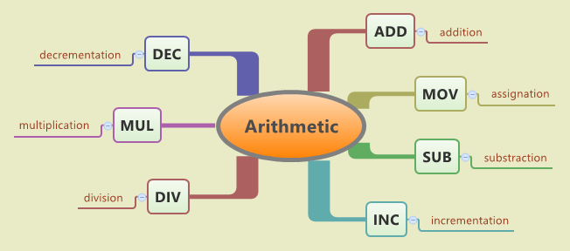
Arithmetic Instructions
Picture Courtesy :Google

Slide 37
Arithmetic Instructions
ADD: The general format of ADD instruction is
ADD destination, source
The data from the source and destination are added and the result is placed in the destination. The source may be an immediate number, a register or a memory location. The destination can be a register or memory location. But the source and destination cannot both be memory locations. The data from the source and destination must be of the same type either bytes or words.
Examples: ADD BL,80H; Add immediate data 80H to BL
ADD CX,12B0H; Add immediate data 12B0H to CX
ADD AX,CX; Add content of AX and CX and store result in AX
ADD AL,[BX]; Add content of AL and the byte from memory at [BX] and store result in AL.
ADD CX,[SI]; Add content of CX and the word from memory at [SI] and store result in CX.
ADD [BX],DL; Add content of DL with the byte from memory at [BX] and store result in memory at [BX].
The flags AF, CF, OF, PF, SF and ZF flags are affected by the execution of ADD instruction

Slide 38
Arithmetic Instructions
ADC: This instruction adds the data in source and destination along with the content of carry flag and stores the result in the destination. The general format of this instruction is
ADC destination, source
All the rules specified for ADD is also applicable for ADC instruction.
SUB: The general form of subtract (SUB) instruction is
SUB destination, source
It subtracts the number in the source from the number in the destination and stores the result in destination. The source may be an immediate number, a register or a memory location. The destination can be a register or memory location. But the source and destination cannot both be memory locations. The data from the source and destination must be of the same type either bytes or words.

Slide 39
Arithmetic Instructions
For subtraction, the carry flag (CF) functions as borrow flag. If the result is negative after subtraction, CF is set, otherwise it is reset. The rules for source and destination are same as that of ADD instruction. The flags AF, CF, OF, PF, SF and ZF are affected by SUB instruction.
Examples:
SUB AL, BL; Subtract BL from AL and store result in AL
SUB CX, BX; Subtract BX from CX and store result in CX
SUB BX, [DI]; Subtract the word in memory at [DI] from BX and store result in BX
SUB [BP], DL; Subtract DL from the byte in memory at [BP] and store result in memory at [BP].

Slide 40
Arithmetic Instructions
SBB: Subtract with Borrow
The general form of this instruction is
SBB destination, source
SBB instruction subtracts the content of source and content of carry flag from the content of destination and stores the result in destination. The rules for the source and destination are same as that of SUB instruction.
AF, CF, OF, PF, SF and ZF are affected by this instruction.

Slide 41
Arithmetic Instructions
INC: The increment (INC) instruction adds 1 to a specified register or to a memory location. The data incremented may be a byte or word. Carry flag is not affected by this instruction. AF, OF, PF, SF and ZF flags are affected.
Examples:
INC CL; Increment content of CL by 1
INC AX; Increment content of AX by 1
INC BYTE PTR [BX]; Increment byte in memory at [BX] by 1
INC WORD PTR [SI]; Increment word in memory at [SI] by 1
In the above examples, the term BYTE PTR and WORD PTR are assembler directives which are used to specify the type of data (byte or word respectively) to be incremented in memory.

Slide 42
Arithmetic Instructions
DEC: The decrement (DEC) instruction subtracts 1 from the specified register or memory location. The data decremented may be a byte or word. CF is not affected and AF,OF, PF, SF and ZF flags are affected by this instruction.
NEG: The negate (NEG) instruction replaces the byte or word in the specified register or memory location by its 2’s complement (i.e. changing the sign of the data). CF,AF, SF, PF, ZF and OF flags are affected by this instruction.
Examples:
NEG AL; Take 2’s complement of the data in AL and store it in AL
NEG CX; Take 2’s complement of the data in CX and store it in CX
NEG BYTE PTR[BX]; Take 2’s complement of the byte in memory at [BX] and store result in the same place.
NEG WORD PTR[SI]; Take 2’s complement of the word in memory at [SI] and store result in the same place.

Slide 43
Arithmetic Instructions
CMP: The general form of compare (CMP) instruction is given below:
CMP destination, source
This instruction compares a byte or word in the source with a byte or word in the destination and affects only the flags according to the result. The content of source and destination are not affected by the execution of this instruction. The comparison is done by subtracting the content of source from destination.
AF, OF, SF, ZF, PF and CF flags are affected by the instruction. The rules for source and destination are same as that of SUB instruction.
Example:
After the instruction CMP AX, DX is executed, the status of CF, ZF and SF will be as follows:
CF ZF SF
If AX=DX 0 1 0
If AX>DX 0 0 0
If AX<DX 1 0 1

Slide 44
Arithmetic Instructions
MUL: The multiply (MUL) instruction is used for multiplying two unsigned bytes or words. The general form of MUL instruction is
MUL Source
The source can be byte or word from a register or memory location which is considered as the multiplier. The multiplicand is taken by default from AL or AX for byte or word type data respectively. The result of multiplication is stored in AX or DX-AX (i.e. Most significant word of result in DX and least significant word of result in AX) for byte or word type data respectively. (Note: Multiplying two 8 bit data gives 16 bit result and multiplying two 16 bit data gives 32 bit result).
Examples:
MUL CH; Multiply AL and CH and store result in AX
MUL BX; Multiply AX and BX and store result in DX-AX
MUL BYTE PTR [BX]; multiply AL with the byte in memory at [B X] and store result in DX-AX
If the most significant byte of the 16 bit result is 00H or the most significant word of a 32 bit result is 0000h, both CF and OF will both be 0s. Checking these flags allows us to decide whether the leading 0s in the result have to be discarded or not. AF, PF, SF and ZF flags are undefined (i.e. some random number will be stored in these bits) after the execution of MUL instruction

Slide 45
Arithmetic Instructions
IMUL: The IMUL instruction is used for multiplying signed byte or word in a register or memory location with AL or AX respectively and stores the result in AX or DX-AX respectively. If the magnitude of the result does not require all the bits of the destination, the unused bits are filled with copies of the sign bit.
If the upper byte of a 16 bit result or upper word of a 32 bit result contains only copies of the sign bit (all 0s or all 1s) then CF and OF will both be 0 otherwise both will be 1. AF, PF, SF and ZF are undefined after IMUL.
To multiply a signed byte by a signed word, the byte is moved into a word location and the upper byte of the word is filled with the copies of the sign bit. If the byte is moved into AL, by using the CBW (Convert Byte to Word) instruction, the sign bit in AL is extended into all the bits of AH. Thus AX contains the 16 bit sign extended word.
Examples:
IMUL BL; multiply AL with BL and store result in AX
IMUL AX; multiply AX and AX and store result in DX-AX
IMUL BYTE PTR [BX]; multiply AL with byte from memory at [BX] and store result in AX
IMUL WORD PTR [SI]; Multiply AX with word from memory at [SI] and store result in DX-AX

Slide 46
Arithmetic Instructions
DIV: The divide (DIV) instruction is used for dividing unsigned data. The general form of DIV instruction is
DIV source
Where source is the divisor and it can be a byte or word in a register or memory location. The dividend is taken by default from AX and DX-AX for byte or word type data division respectively.
Examples
DIV DL; Divide word in AX by byte in DL. Quotient is stored in AL and remainder is stored in AH
DIV CX; Divide double word (32 bits) in DX-AX by word in CX. Quotient is stored in AX and remainder is stored in DX
DIV BYTE PTR [BX]; Divide word in AX by byte from memory at [BX]. Quotient is stored in AL and remainder is stored in AH.

Slide 47
Arithmetic Instructions
IDIV: The IDIV instruction is used for dividing signed data. The general form and the rules for IDIV instruction are same as DIV instruction. The quotient will be a signed number and the sign of the remainder is same as the sign of the dividend.
To divide a signed byte by a signed byte, the dividend byte is put in AL and using CBW (Convert Byte to Word) instruction, the sign bit of the data in AL is extended to AH and thereby the byte in AL is converted to signed word in AX. To divide a signed word by a signed word, the dividend byte is put in AX and using CWD (Convert Word to Double word) instruction, the sign bit of the data in AX is extended to DX and thereby the word in AX is converted to signed double word in DX-AX.
If an attempt is made to divide by 0 or if the quotient is too large or two low to fit in AL or AX for 8 or 16 bit division respectively (i.e. either when the result is greater than +127 decimal in 8 bit division or +32767 decimal in 16 bit division or if the result is less than -128 decimal in 8 bit division or -32767 decimal in 16 bit division), the 8086 automatically generate a type 0 interrupt. All flags are undefined after a DIV instruction.

Slide 48
Arithmetic Instructions
DAA: Decimal Adjust AL after BCD addition
This instruction is used to get the result of adding two packed BCD numbers (two decimal digits are represented in 8 bits) to be a BCD number. The result of addition must be in AL for DAA to work correctly. If the lower nibble (4 bits) in AL is greater than 9 after addition or AF flag is set by the addition then the DAA will add 6 to the lower nibble in AL. If the result in the upper nibble of AL is now greater than 9 or if the carry flag is set by the addition, then the DAA will add 60H to AL.
Examples:
Let AL=0101 1000=58 BCD
CL=0011 0101=35 BCD
Consider the execution of the following instructions:
ADD AL, CL; AL=10001101=8DH and AF=0 after execution
DAA - Add 0110 (decimal 6) to AL since lower nibble in AL is greater than 9
AL=10010011= 93 BCD and CF=0
Therefore the result of addition is 93 BCD.

Slide 49
Arithmetic Instructions
DAS: Decimal Adjust after BCD subtraction
DAS is used to get the result is in correct packed BCD form after subtracting two packed BCD numbers. The result of the subtraction must be in AL for DAS to work correctly. If the lower nibble in AL after a subtraction is greater than 9 or the AF was set by subtraction then the DAS will subtract 6 from the lower nibble of AL. If the result in the upper nibble is now greater than 9 or if the carry flag was set, the DAS will subtract 60H from AL.
Examples:
Let AL=86 BCD=1000 0110
CH=57 BCD=0101 0111
Consider the execution of the following instructions:
SUB AL, CH; AL=0010 1111=2FH and CF=0 after execution
DAS; Lower nibble of result is 1111, so DAS subtracts 06H from AL to make
AL=0010 1001=29 BCD and CF=0 to indicate there is no borrow.
The result is 29 BCD.

Slide 50
Arithmetic Instructions
AAA:
AAA (ASCII Adjust after Addition) instruction must always follow the addition of two unpacked BCD operands in AL. When AAA is executed, the content of AL is changed to a valid unpacked BCD number and clears the top 4 bits of AL. The CF is set and AH is incremented if a decimal carry out from AL is generated.
Example:
Let AL=05 decimal=0000 0101
BH=06 decimal=0000 0100
AH=00H
Consider the execution of the following instructions:
ADD AL, BH ; AL=0BH=11 decimal and CF=0
AAA ; AL=01 and AH=01 and CF=1
Since 05+06=11(decimal)=0101 H stored in AX in unpacked BCD form.
When this result is to be sent to the printer, the ASCII code of each decimal digit is easily formed by adding 30H to each byte.

Slide 51
Arithmetic Instructions
AAS: ASCII Adjust after Subtraction
This instruction always follows the subtraction of one unpacked BCD operand from another unpacked BCD operand in AL. It changes the content of AL to a valid unpacked BCD number and clears the top 4 bits of AL. The CF is set and AH is decremented if a decimal carry occurred.
Example:
Let AL=09 BCD=0000 1001
CL=05 BCD =0000 0101
AH=00H
Consider the execution of the following instructions:
SUB AL, CL; AL=04 BCD
AAS ; AL=04 BCD and CF=0
; AH=00H
AAA and AAS affect AF and CF flags and OF, PF, SF and ZF are left undefined. Another salient feature of the above two instructions are that the input data used in the addition or subtraction can be even in ASCII form of the unpacked decimal number and still we get the result in ordinary unpacked decimal number form and by adding 30H to the result , again we get ASCII form of the result.

Slide 52
Arithmetic Instructions
AAD: The ASCII adjust AX before Division instruction modifies the dividend in AH and AL, to prepare for the division of two valid unpacked BCD operands. After the execution of AAD, AH will be cleared and AL will contain the binary equivalent of the original unpacked two digit numbers. Initially AH contains the most significant unpacked digit and AL contains the least significant unpacked digit.
Example: To perform the operation 32 decimal / 08 decimal
Let AH=03H; upper decimal digit in the dividend
AL=02H; lower decimal digit in the dividend
CL=08H; divisor
Consider the execution of the following instructions:
AAD; AX=0020H (binary equivalent of 32 decimal in 16 bit form)
DIV CL; Divide AX by CL; AL will contain the quotient and AH will contain the remainder.
AAD affects PF, SF and ZF flags. AF, CF and OF are undefined after execution of AAD.

Slide 53
Arithmetic Instructions
AAM: The ASCII Adjust AX after Multiplication instruction corrects the value of a multiplication of two valid unpacked decimal numbers. The higher order digit is placed in AH and the low order digit in AL.
Example:
Let AL=05 decimal
CL=09 decimal
Consider the execution of the following instructions:
MUL CH; AX=002DH=45 decimal
AAM; AH=04 and AL=05 ( unpacked BCD form decimal number of 45)
OR AX, 3030H; To get ASCII code of the result in AH and AL (Note:this instruction is used only when it is needed). AAM affects flags same as that of AAD.

Slide 54
Example-Simple programs
MOV AX, [1100]
MOV BX, [1102]
ADD AX,BX
MOV [1200],AX
HLT
MOV AX, [1100]
MOV BX, [1102]
SUB AX,BX
MOV [1200],AX
HLT
MOV AX, [1100]
MOV BX, [1102]
MUL BX
MOV [1200],AX
MOV [1202],DX
HLT
MOV AX, [1100]
MOV BX, [1102]
DIV BX
MOV [1200],AX
MOV [1202],DX
HLT

Slide 55
Learning Resources
K. M. Bhurchandi and A. K. Ray, Advanced Microprocessors and Peripherals-with ARM and an Introduction to Microcontrollers and Interfacing, 3rd edition, Tata McGraw Hill, 2015.
Yu-cheng Liu, Glenn A. Gibson, Microcomputer systems: The 8086/8088 family-Architecture, programming and design, 2nd edition, Prentice Hall of India, 2007.

Slide 56
Thank You

